Slide 1
Behaviorist Views of Learning
Manidheeraj

Slide 2
What is Behaviorism ?
Behaviourism learning theory is the idea that how a student behaves is based on their interaction with their environment.
Behaviour is determined by the environment through either association or reinforcement

Slide 3
Types Of Behavioural Learning Theory
Classical Conditioning
Operant Conditioning
Observational Learning

Slide 4
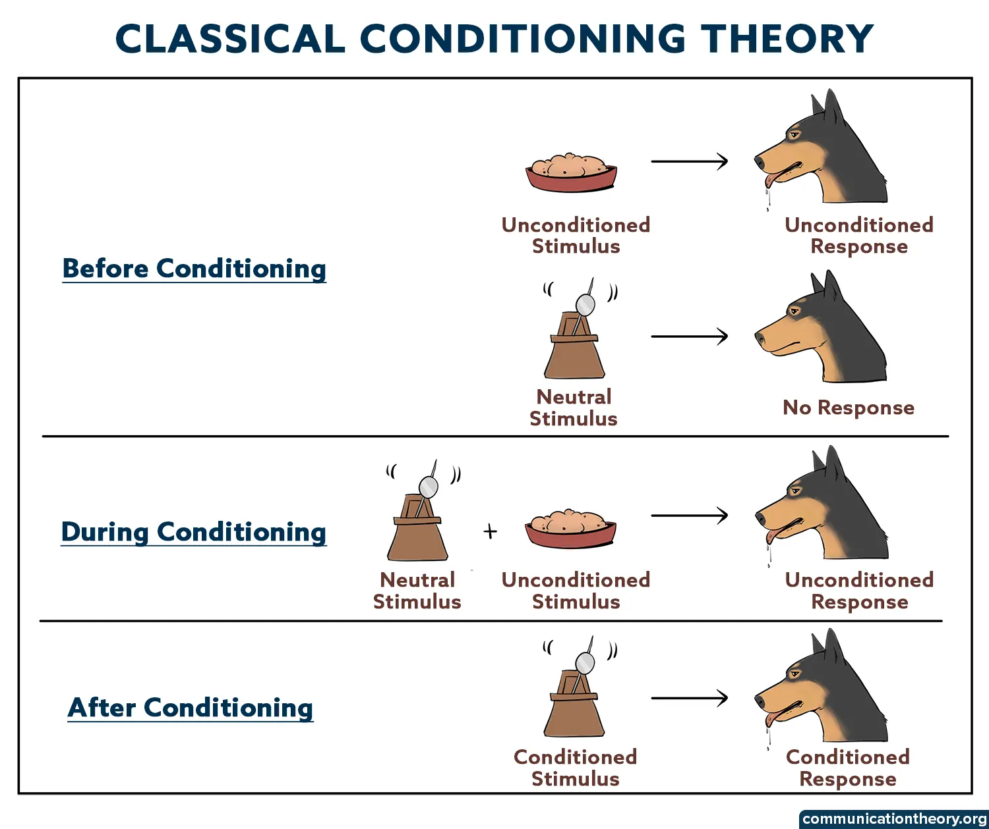

Slide 5
Operant Conditioning
Positive Reinforcement : offering rewards or incentives to strengthen desired behaviors.
Negative Reinforcement : Removal of an unpleasant stimulus to increase desired behavior.
Punishment : Students may become more focused on avoiding punishment rather than learning.
Modeling : Demonstrating desired behaviors for students to observe and imitate, fostering learning and shaping attitudes.

Slide 6
Observational Learning
Observational learning involves watching and imitating others' behaviors.
Provides models for imitation, particularly during childhood, shaping social behavior.
Children learn social norms and behaviors by observing parents, peers, and significant others.

Slide 7
Why it is important?
Clarity in Learning Objectives: Students can better understand what is expected of them, facilitating focused learning.
Skill Acquisition: Helps students develop essential skills by reinforcing positive behaviors and responses.
Measurable Progress: Allows students to track their own progress by observing changes in their behavior over time.

Slide 8
THANK YOU

